Slide 1




Alzheimer’s Disease Prediction using Traditional ML Algorithms on Cross – Sectional MRI Images
Presented By
V. Lakshmi Devi
PG Scholar
Department of Data Science
St. Xavier’s College (Autonomous)
Palayamkottai

Slide 2


ABSTRACT
Alzheimer's Disease (AD) is a leading cause of dementia among older adults, marked by progressive memory loss and cognitive decline, with no cure.
Early detection is crucial for effective intervention, as treatment can slow symptom progression if administered at initial stages.
This study aims to improve early AD diagnosis using machine learning (ML) on MRI cross-sectional images and clinical data from the OASIS-1 dataset, which includes 390 MRI scans linked to clinical information.
Various ML models, including Random Forest, SVM, CNN, and XGBoost, were applied to analyze both image and clinical features for dementia classification.
Model performances were evaluated by accuracy, precision, recall, and F1-score, with XGBoost achieving 100% accuracy and SVM achieving 91%, demonstrating the potential of ML models to enable early AD diagnosis and improved patient outcomes.

Slide 3
BRIEF ABOUT KEYWORDS
MRI Imaging: Magnetic Resonance Imaging provides detailed brain scans, crucial for detecting structural changes associated with AD.
Random Forest: An ensemble learning method that uses multiple decision trees to improve prediction accuracy and handle complex data.
XGBoost: A high-performance ML model utilizing gradient boosting, known for its efficiency and accuracy in predictive modeling.
Convolutional Neural Networks (CNN): A deep learning model ideal for image analysis, extracting features from MRI data for AD prediction.

Slide 4
Support Vector Machine (SVM): A supervised learning model that identifies the optimal boundary between classes, useful for classification tasks.
OASIS-1 Dataset: A dataset containing MRI scans and clinical data for studying AD, used in this study for predictive modeling.
Dementia and Cognitive Decline: Conditions characterized by a decline in mental ability, memory, and reasoning, commonly associated with AD.

Slide 5
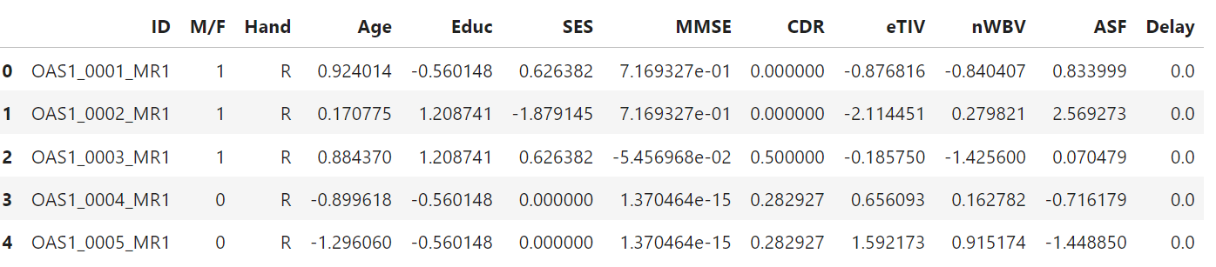
PROPOSED WORK
Objective:
Developed a method for early detection of Alzheimer’s Disease (AD) using machine learning on clinical data and MRI images from the OASIS-1 dataset.
Dataset:
390 MRI images (SUBJ_111 and T88_111)
Clinical features: Age, Education, SES, MMSE, CDR, eTIV, nWBV

Slide 6
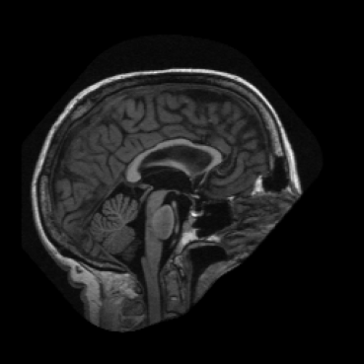
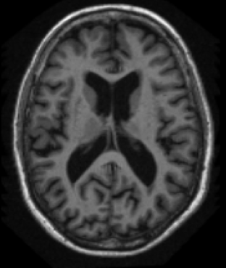
SUBJ_111
Preprocessing:
Handle missing values with mean/mode imputation
Encode categorical data and scale numerical features
Feature Extraction:
Extract features from MRI images using ResNet50
Combine clinical and MRI features for holistic input
Goal:
Classify subjects:
Dementia (CDR ≥ 0.5)
No Dementia (CDR < 0.5)
T88_111

Slide 7
METHODS APPLIED
1. Data Preprocessing:
Handling Missing Values:
Mean imputation for SES, MMSE, and Delay
Mode imputation for Education
Encoding: Gender transformed (M = 0, F = 1)
Feature Scaling: Standardized numerical features using StandardScaler
2. Feature Extraction:
Clinical Data: Selected key features like Age, MMSE, CDR, and nWBV
MRI Data: Extracted 2048-dimensional features using ResNet50
Feature Integration: Combined MRI and clinical features for comprehensive modeling

Slide 8
3. Machine Learning Models Implemented:
Random Forest (RF): Ensemble learning to reduce overfitting
Support Vector Machine (SVM): Linear kernel for high-dimensional separation
Convolutional Neural Network (CNN): Specialized deep learning for image analysis
XGBoost: Gradient boosting for robust performance with complex interactions
4. Evaluation Metrics:
Accuracy, Precision, Recall, F1-Score, and Confusion Matrix to assess model performance

Slide 9
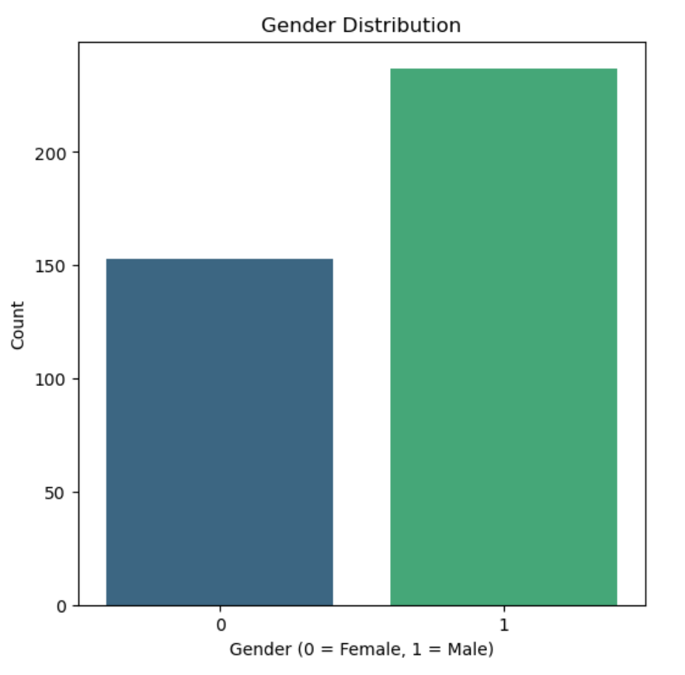
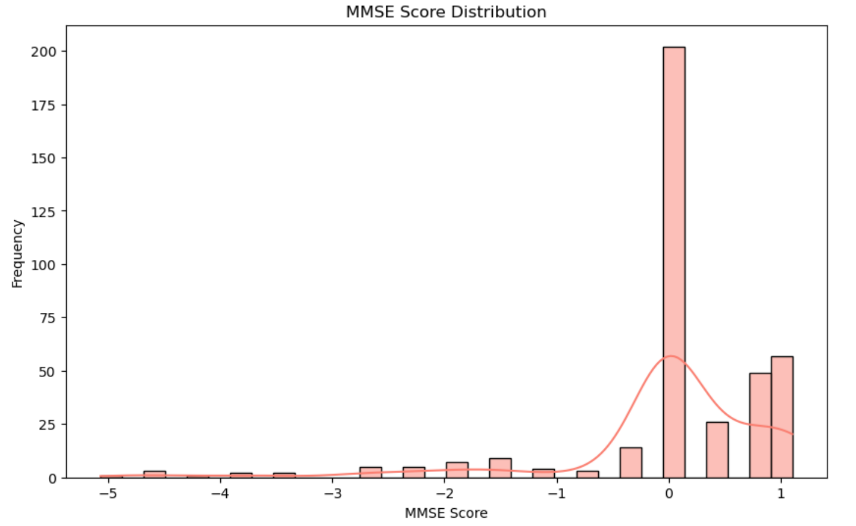
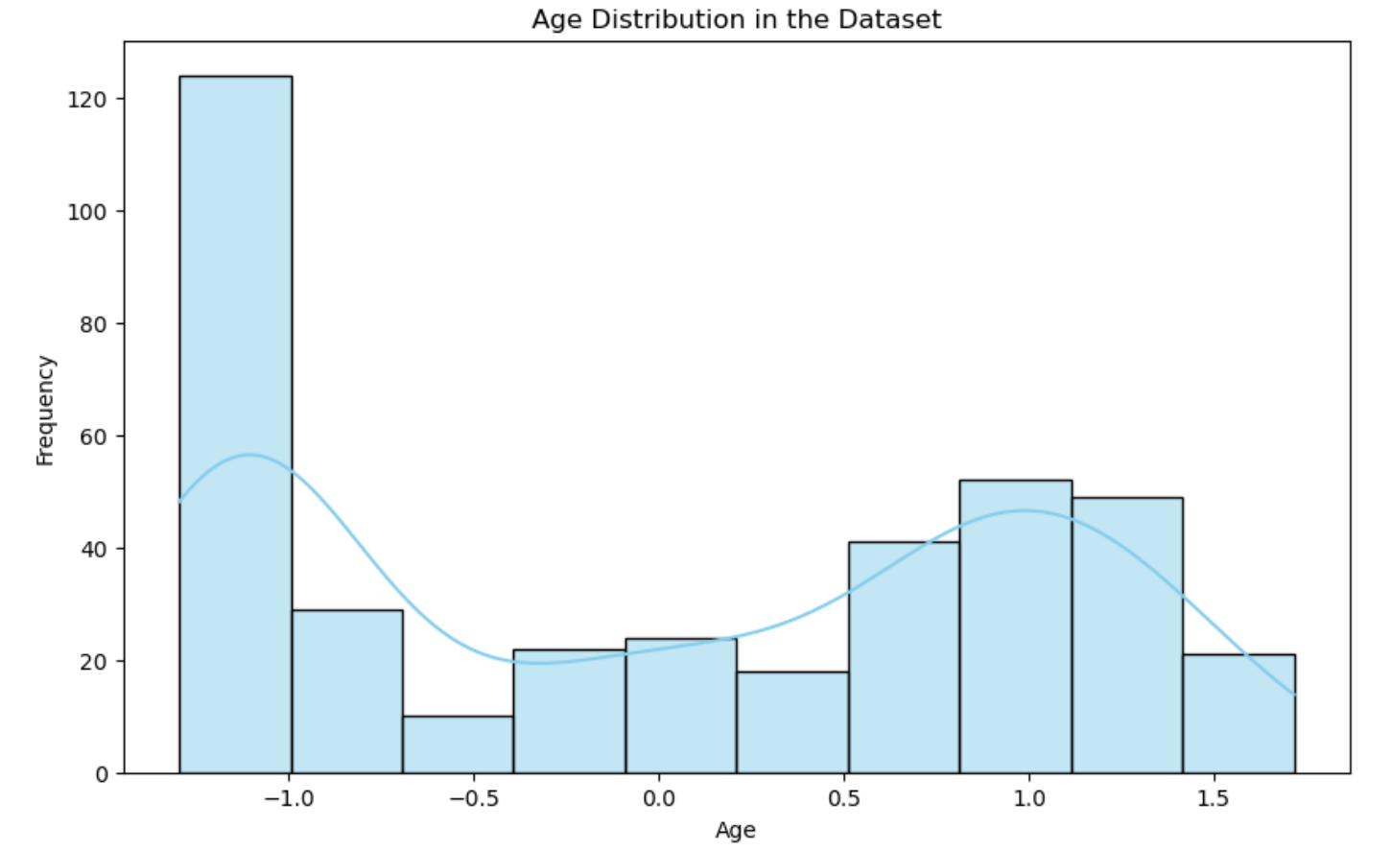
RESULTS
Model Performance:
XGBoost: 100% Accuracy
Random Forest: 90% Accuracy
SVM: 91% Accuracy
CNN: 81% Accuracy

Slide 10
Observations:
XGBoost: Achieved perfect accuracy, indicating its capability to handle both tabular clinical data and high-dimensional MRI features effectively. Its robustness in managing feature interactions makes it the most suitable model for AD prediction.
SVM: Performed with near-perfect accuracy, confirming the strength of ensemble techniques for early-stage detection. It handled overfitting well, even with the mixed data types.
Random Forest: Though accurate, it struggled compared to ensemble models, suggesting it might not capture complex feature patterns as effectively. However, it remains a reliable option for smaller datasets.
CNN: Demonstrated lower accuracy, revealing that deep learning architectures may require more refined image processing techniques or a larger dataset to reach optimal performance.

Slide 11
CONCLUSION
As we conclude our exploration of early detection in Alzheimer's disease, we recognize the significance of our findings and their potential to drive future research. By effectively utilizing the OASIS-1 dataset, we established a crucial connection between MRI cross-sectional images and clinical data, which is vital for identifying early indicators of AD. The encouraging results obtained through our initial analyses demonstrate the promise of machine learning in this vital area.
Looking ahead, we are particularly excited about the incorporation of PET scans into our research. This advanced imaging technique will provide a deeper understanding of the biological mechanisms underlying Alzheimer's disease and enhance our diagnostic capabilities. Our commitment to improving early detection remains steadfast, and we are hopeful that our work will contribute to a future where Alzheimer's disease can be diagnosed sooner and managed more effectively, ultimately benefiting those at risk.

Slide 12

Thank You

